Slide 1
SERS-Based Nanobiosensor Workflow for Sepsis Diagnostics

Slide 2

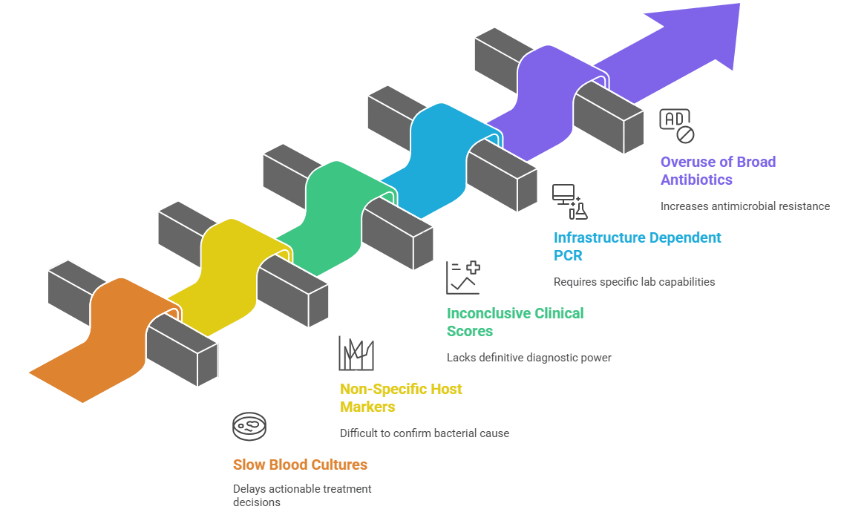
































































































































Clifiical Urgeficy of Sepsis
Approximately 49 million sepsis cases globally (2020) with ~11 million deaths.
Early detection and treatment are critical; delays increase mortality.
Sepsis is a major contributor to hospital fatalities and ICU burden.
Limitatiofis of Currefit Diagfiostics

Slide 3
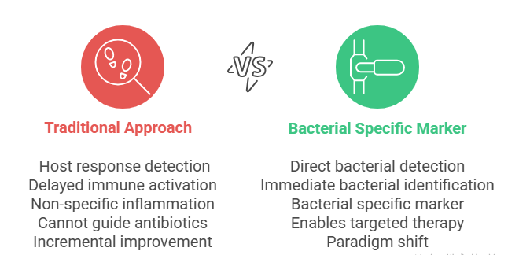
Why Bacterial-Specific Biomarkers?
Early diagnosis and improved clinical outcomes.
Directly indicate the presence of bacteria (not just host inflammation).
Enable Gram classification. Reduce unnecessary broad-spectrum antibiotic use and combat AMR.

Slide 4

Difference
Gram-Positive
Gram-Negative
Clinical Significance
Reference
Thin peptidoglycan + outer membrane
Determines antibiotic
penetration and SERS targeting strategy
Silhavy et al. Cold Spring Harb Perspect Biol 2010;2(5):a000414
Cell Wall Structure
Thick peptidoglycan (20-80 nm)
Peptidoglycan Content
90% of cell wall mass
5-10% of cell wall mass
Major structural target for β- lactam antibiotics and detection
Vollmer et al. FEMS Microbiol Rev 2008;32(2):149-167
Primary resistance mechanism; barrier to drugs and immune system
Nikaido H. Microbiol Mol Biol Rev 2003;67(4):593-656
Outer Membrane
Absent
Present (barrier function)
Lipopolysaccharide (LPS)
Absent
Present (endotoxin component)
Major sepsis mediator; triggers cytokine storm and shock
Raetz & Whitfield. Annu Rev Biochem 2002;71:635-700
Gram Staining
Purple/Violet (retains stain)
Pink/Red (loses stain)
Primary laboratory identification method (95% accuracy)
Gram HC. Fortschr Med 1884;2:185-189
Antibiotic Susceptibility
Generally, more susceptible
More resistant (outer membrane)
Guides empirical antibiotic
selection in sepsis management
Delcour AH. Biochim Biophys Acta 2009;1794(5):808-816
Endotoxin Production
No endotoxin
Lipid A endotoxin present
Key pathophysiology difference in sepsis severity and outcomes
Rietschel et al. FASEB J 1994;8(2):217-225
Clinical Presentation
Device infections, pneumonia
UTI, septic shock, HAI
Influences infection source,
severity, and treatment approach
Martin et al. N Engl J Med 2003;348(16):1546-1554

Slide 5


Proposed Bacterial Biomarkers pafiel
Universal Bacterial Detection: Peptidoglycan fragments (N- acetylmuramic acid)
Reason : Present in ALL bacteria, absent in viruses/fungi/parasites . Direct bacterial confirmation.Unique to bacterial peptidoglycan only.
Gram-negative: Lipopolysaccharide (LPS) — lipid A & O-antigen .
Reason :present Only in Gram-negative bacteria, absent in all other organisms.Strong enhancement, endotoxin correlation
Gram-positive: Lipoteichoic acid (LTA) and wall teichoic acids (WTA).
Reason : present Only in Gram-positive bacteria , surface accessibility

Slide 6
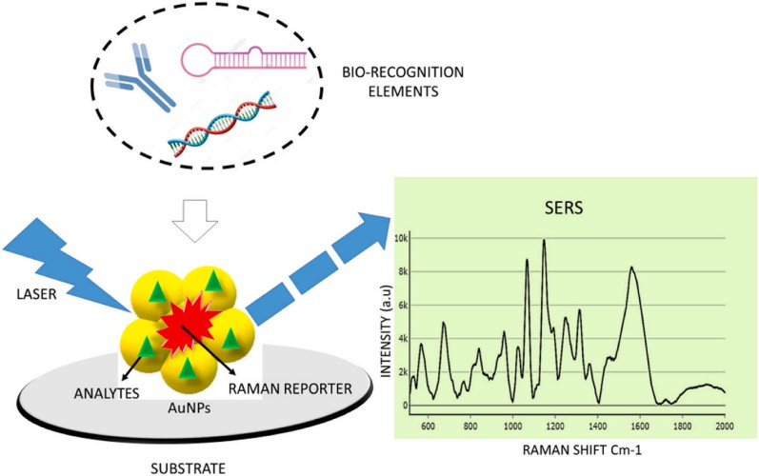
SERS N6fiobiosefisor: Overview
SERS = Surface-Enhanced Raman Spectroscopy; provides molecular fingerprints.
Plasmonic nanostructures (Ag/Au) create strong local fields (hotspots).
Combine SERS substrate with capture probes (aptamers/antibodies) for selectivity.
SERS Fufid6mefit6ls
Raman scattering measures vibrational modes; specific peaks = molecule signature.
Electromagnetic enhancement from plasmon resonance scales..
Hotspots enhancement; possible.
(nanogaps) give the largest single-molecule sensitivity

Slide 7
N6fiom6teri6ls & Substr6te Desigfi
Choice of metal (Ag stronger SERS; Au more stable) affects resonance.
Particle geometry (stars, rods, gaps) tunes hotspot intensity.
Substrate uniformity & reproducible fabrication are essential for clinical use.
Excit6tiofi W6velefigth & Pr6ctic6l Cofisider6tiofis
Common lasers: 532 nm (resonant dyes), 633 nm, 785 nm (bio- friendly), 1064 nm (high autofluorescence samples).
Balance: stronger scattering (shorter λ) vs. fluorescence/background and sample heating.
Laser power and exposure time must be optimized for clinical samples.

Slide 8
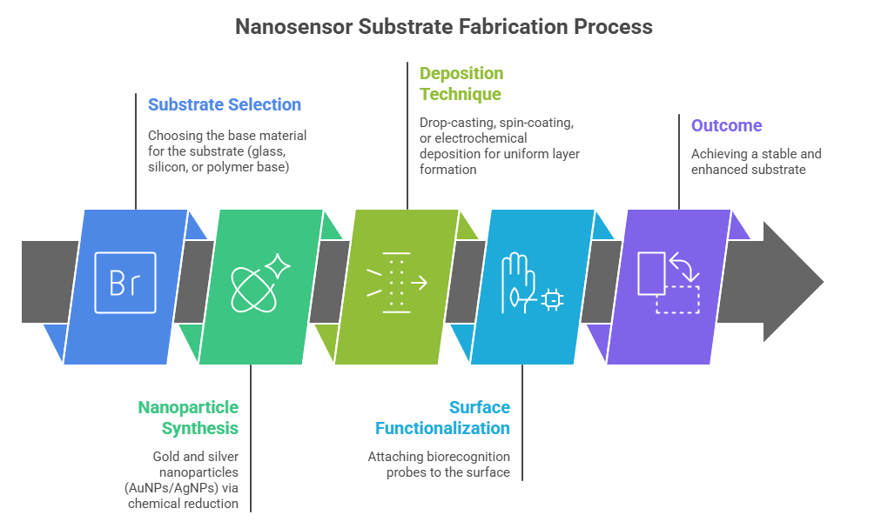
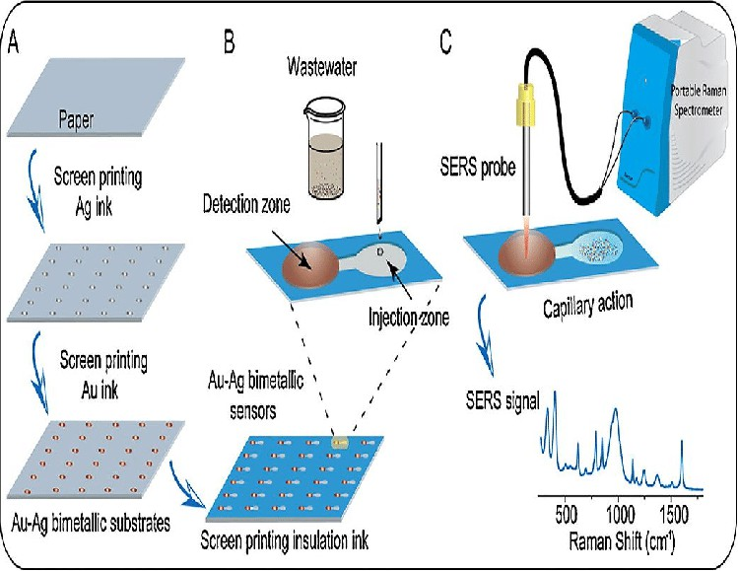
Objective: To develop a reproducible plasmonic substrate with strong Raman enhancement for bacterial biomarker detection (LPS, LTA, PGN).

Slide 9
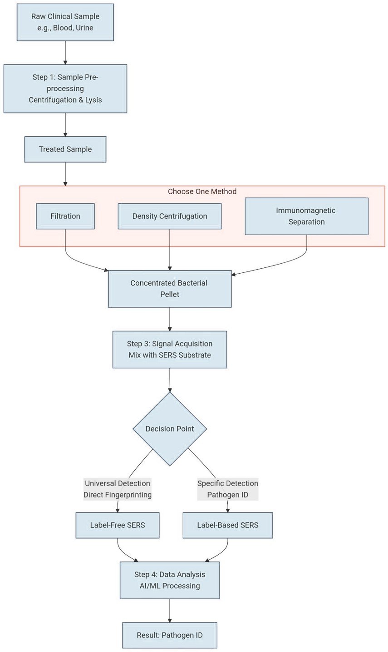
Workflow Pipeline:

Slide 10

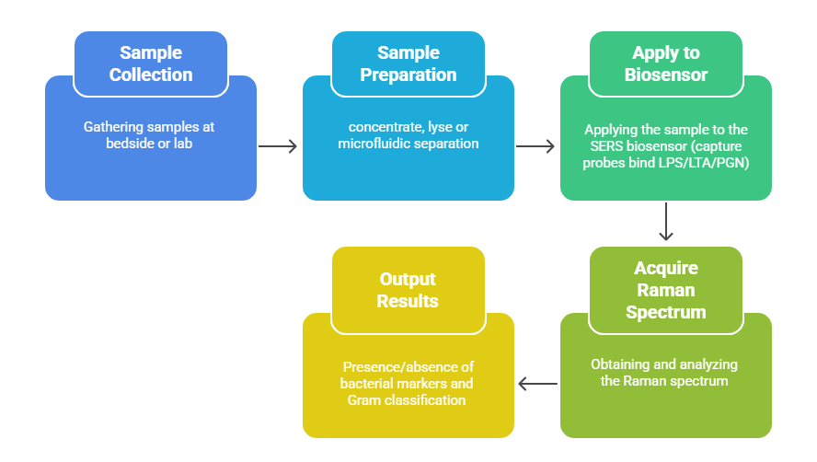
Di6gfiostic Workflow (P6tiefit → Afiswer)

Slide 11
Competitive Advantage & Market Differentiation :
Feature | Blood Culture | PCT/CRP Tests | Our SERS Biosensor
Time-to-Result | 24-72 hours | ~1 hour | < 30 MINUTES *
Pathogen Specificity | Yes | No | YES (Bacterial & Gram-Type)
AMR Guidance | Delayed | No | IMMEDIATE
Platform | Central Lab | Point-of-Care | POINT-OF-CARE
Key Message: With the help of this project we envision to bridge the gap between speed and specificity

Slide 12























































































Clifiic6l Utility & Imp6ct
Rapid Gram-level info enables earlier targeted antibiotics (improves survival).
Less empiric broad-spectrum use → supports antimicrobial stewardship.
Portable SERS devices can enable near-patient, point-of-care testing in ED/ICU.
Ch6llefiges & Ro6dm6p
Extensive literature review done and finalization of biomarker process . SERS simulations initiation to optimize spectral response and substrate design.
Next: experimental validation of simulation results using standard samples.
Prototype fabrication and spectral benchmarking planned in next phase.
Key challenges: ensuring signal reproducibility, substrate uniformity, and scaling for real-world use.
Long-term goal: translate optimized SERS workflow into a portable sepsis diagnostic device.

Slide 13
References
Singer M. et al., The Third International Consensus Definitions for Sepsis and Septic Shock (Sepsis-3). JAMA. 2016.
Kundu A. et al., SERS detection of sepsis biomarkers on Ag–BP platform. Sensors/Diagnostics, 2022.
Hung S. K. et al., Current Evidence and Limitations of Biomarkers for Detecting Sepsis. Biomedicines, 2020.
Hassan M. et al., Advances in Bacterial Detection Using SERS. Biosensors (2024).
Raetz CRH, Whitfield C., Lipopolysaccharide endotoxins. Annu Rev Biochem. 2002.
NICE Guideline NG51, Sepsis: recognition, diagnosis and early management. 2017.
Recent reviews on sepsis biomarkers and SERS-based diagnostics (2023–2025).
Evans L, et al. Crit Care Med. 2021;49(11):e1063-e1143.
10.He R‑R, et al. Sepsis biomarkers: advances and applications. IJMS 2024
9.Wang A, et al. Chem Soc Rev. 2024;53:1108-1132.
11.Langer J, et al. ACS Nano. 2019;14(1):28-117.
12,Karmacharya et al., “Nanoplasmonic SERS on Fidget Spinner for Digital Bacterial Identification,” Microsyst. Nanoeng., 2025
13.Kundu A. et al., “Ultrasensitive and Label-Free Detection of Prognostic and Diagnostic Biomarkers of
Sepsis on a AgNP-laden Black Phosphorus–Based SERS Platform,” Sensors & Diagnostics, 2022.

Slide 14
Thank You

